Slide 1
UNDERSTANDING TUTUM - PART ONE
By
Aqsa Fatima

Slide 2
What we cover in this presentation
Understanding the Architecture of Tutum
Deploying Node from third party in Tutum.
Linking Github Repo
Automated Building from Github
Adding Services from Repository
Tutum on KVM and Baremetal
Update on Node Clusters from third party hosts
Linking containers from different nodes in Tutum
Conclusion

Slide 3
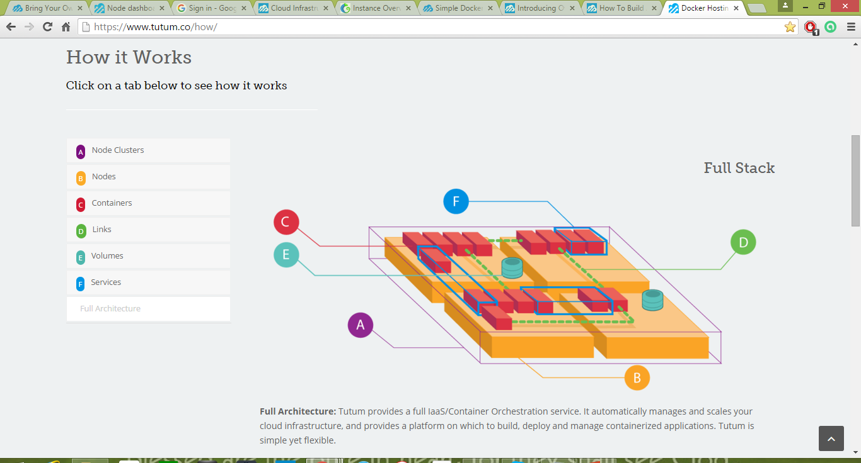
Understanding the Architecture of Tutum

Slide 4
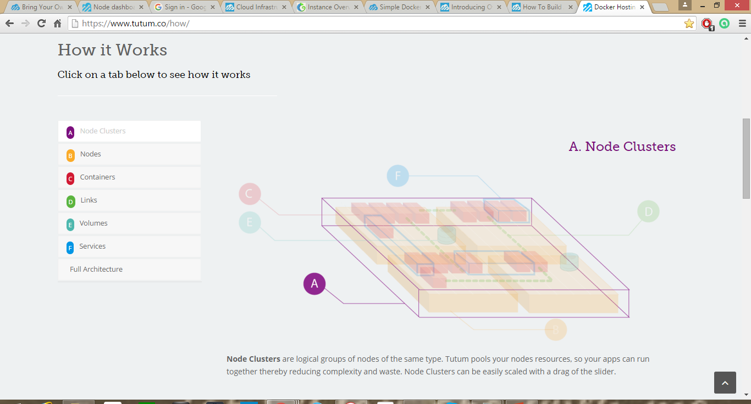
1. Node Cluster

Slide 5
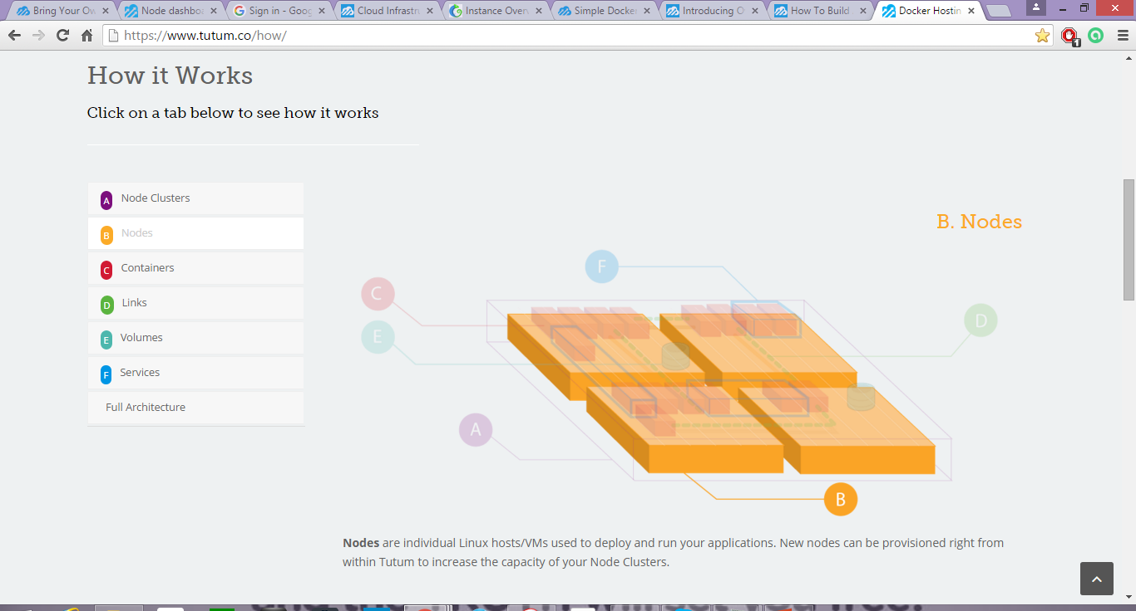
2. Nodes

Slide 6
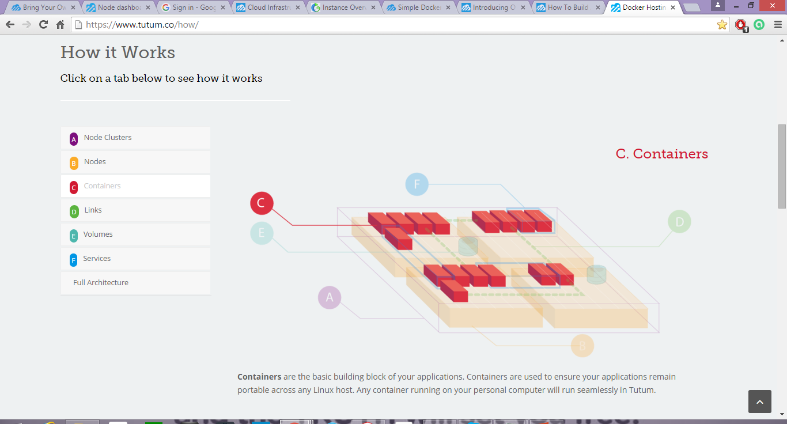
3. Containers

Slide 7
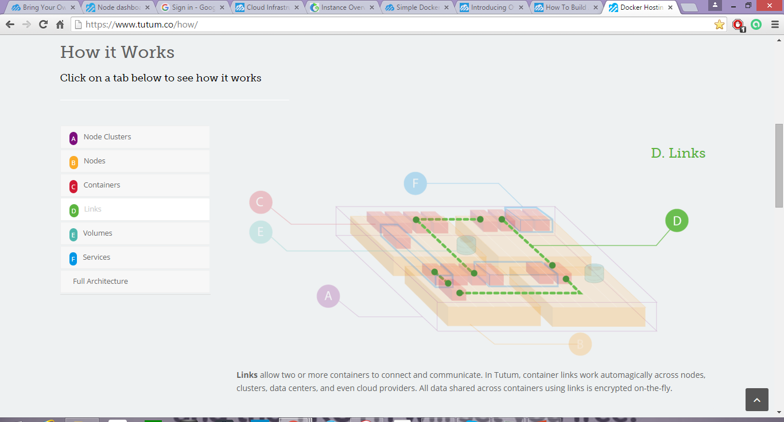
4. Links

Slide 8
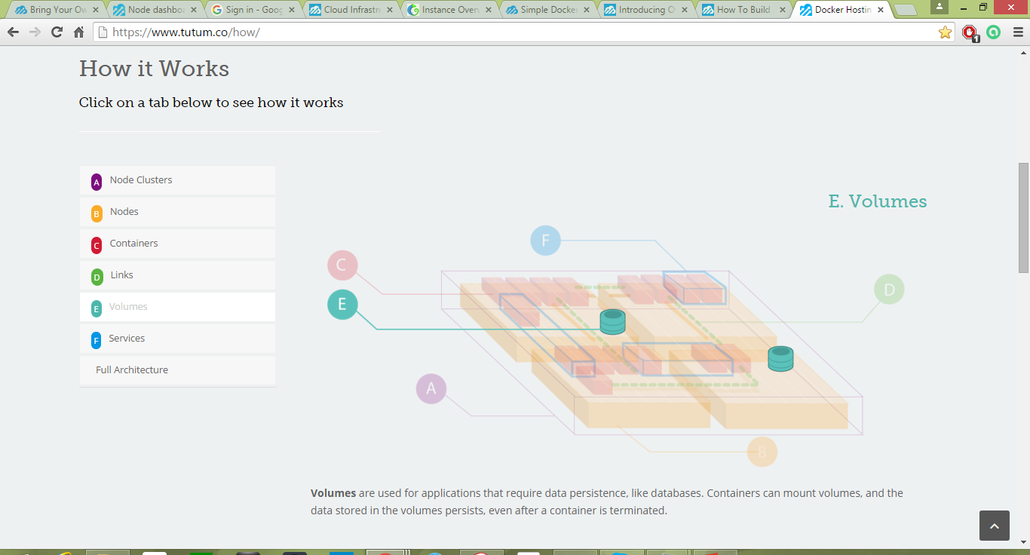
5. Volumes

Slide 9
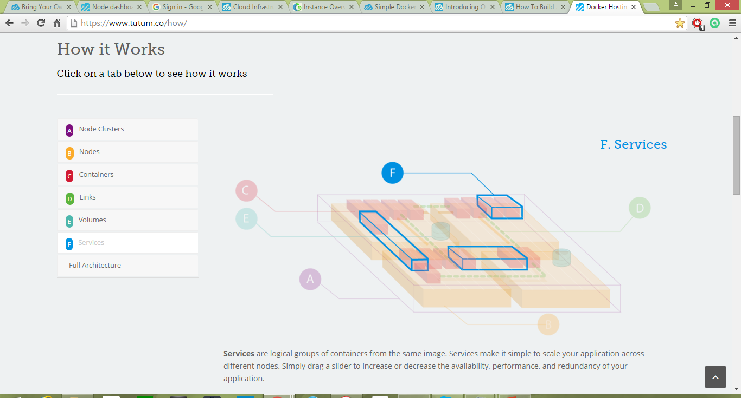
6. Services

Slide 10
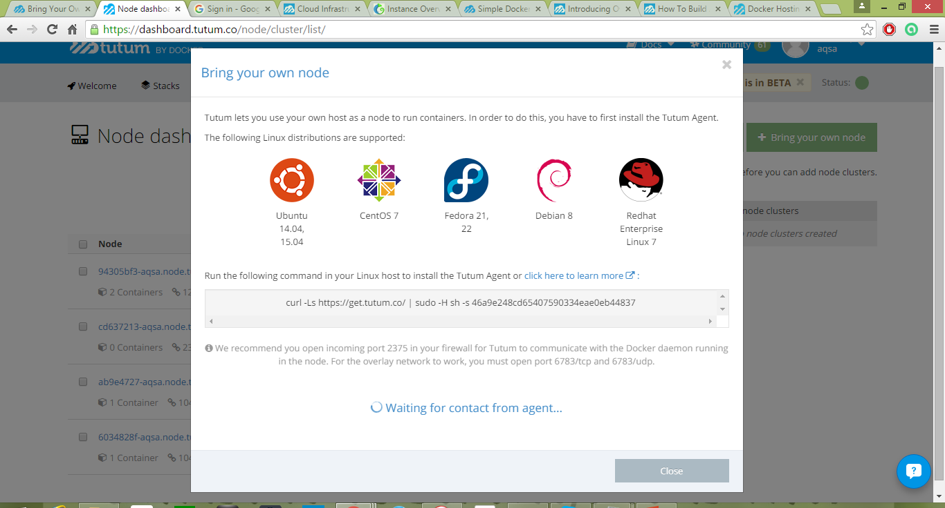
Deploying node from third party
As well as deploying and managing hosts on the supported cloud providers, Tutum can use any Linux host as a node to deploy containers to. For this, we need to install Tutum Agent, which will allow Tutum to remotely manage our host.

Slide 11
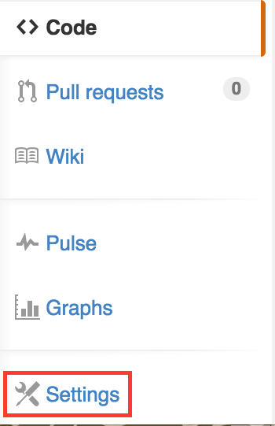
Autobuilding from Github

